Slide 1
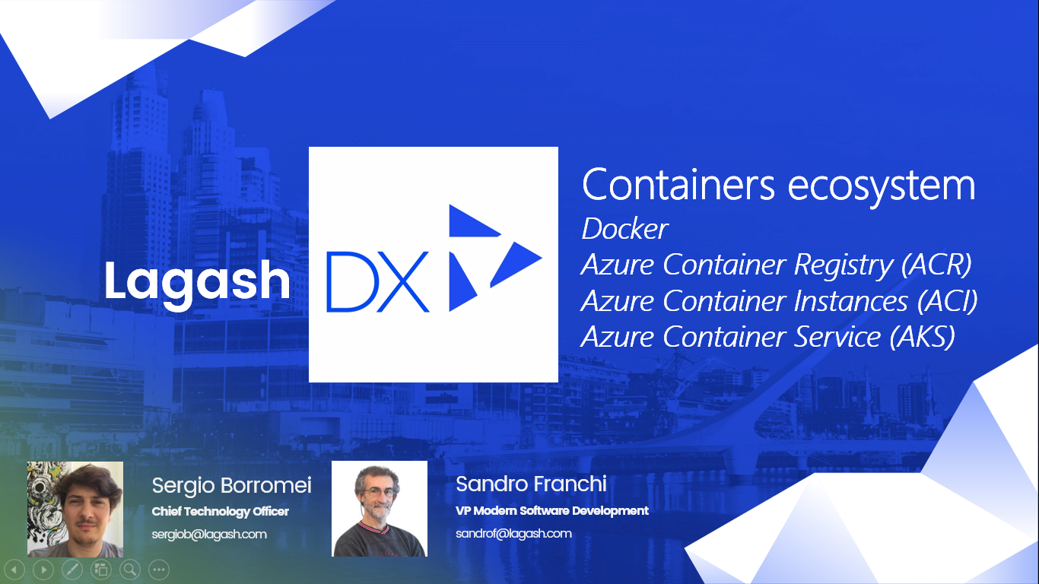

Slide 2

The container advantage
Fast iteration
Agile delivery
Immutability
Cost savings
Efficient deployment
Elastic bursting
For developers
For IT

Slide 3
What is a container?
Containers = operating system virtualization
Traditional virtual machines = hardware virtualization
OS
Application
VM
VM
VM
Applications
Container
Container
Container
App
App
App
Kernel
OS
OS
OS
OS
Hardware
Hardware

Slide 4



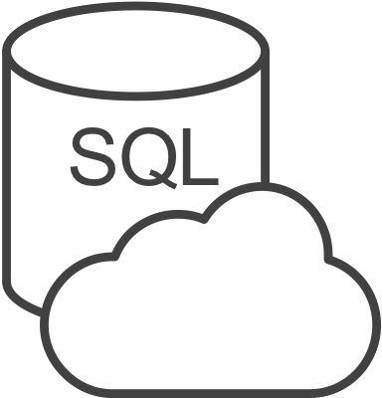

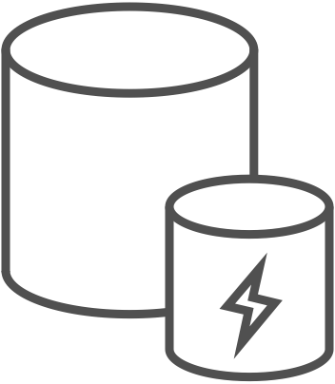

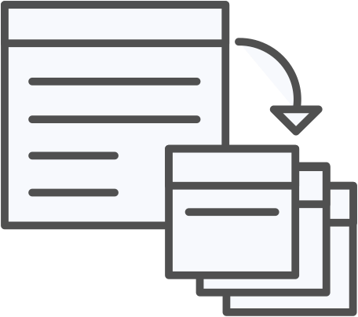



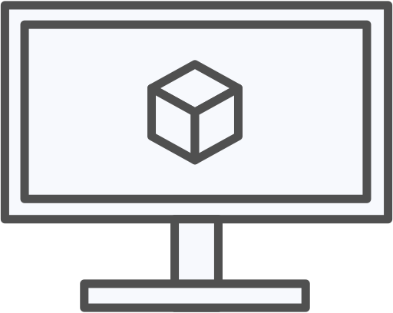
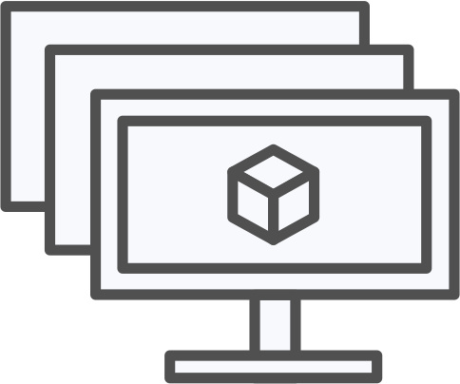
Azure container ecosystem
OSBA
App Service
Azure Container Registry (ACR)
Partner services
Azure services
PaaS
OpenShift
SQL Database
Azure Kubernetes Service (AKS)
Service Fabric
Batch
Pivotal Cloud Foundry
Redis Cache
ACS Engine
Docker Enterprise Edition
CosmosDB
Virtual kubelet
Mesosphere DC/OS
And more!
Azure Container Instances (ACI)
Azure Virtual Machines
Virtual Machine Scale Sets (VMSS)
Azure
IaaS

Slide 5
Virtualization versus containerization
Virtual machine
Container
Application XYZ
Application
App dependencies
Dependencies
Guest OS
C
C
C
C
C
VM
VM
VM
VM
VM
VM
Dependency 1
Dependency 2
Hypervisor 2
Docker Engine
Hypervisor 1
Host OS
Host OS
Hardware
Hardware
Hardware
Type 1
Type 2
Virtualization
Containerization

Slide 6



Azure Container Registry
Azure Container Registry
Open source community
Azure Kubernetes Service (AKS)
Release automation tools
Containers 101
Getting started
Azure container technology
Open Service Broker for Azure (OSBA)
Customer success stories
Container orchestration
Azure Container Instances (ACI)

Slide 7
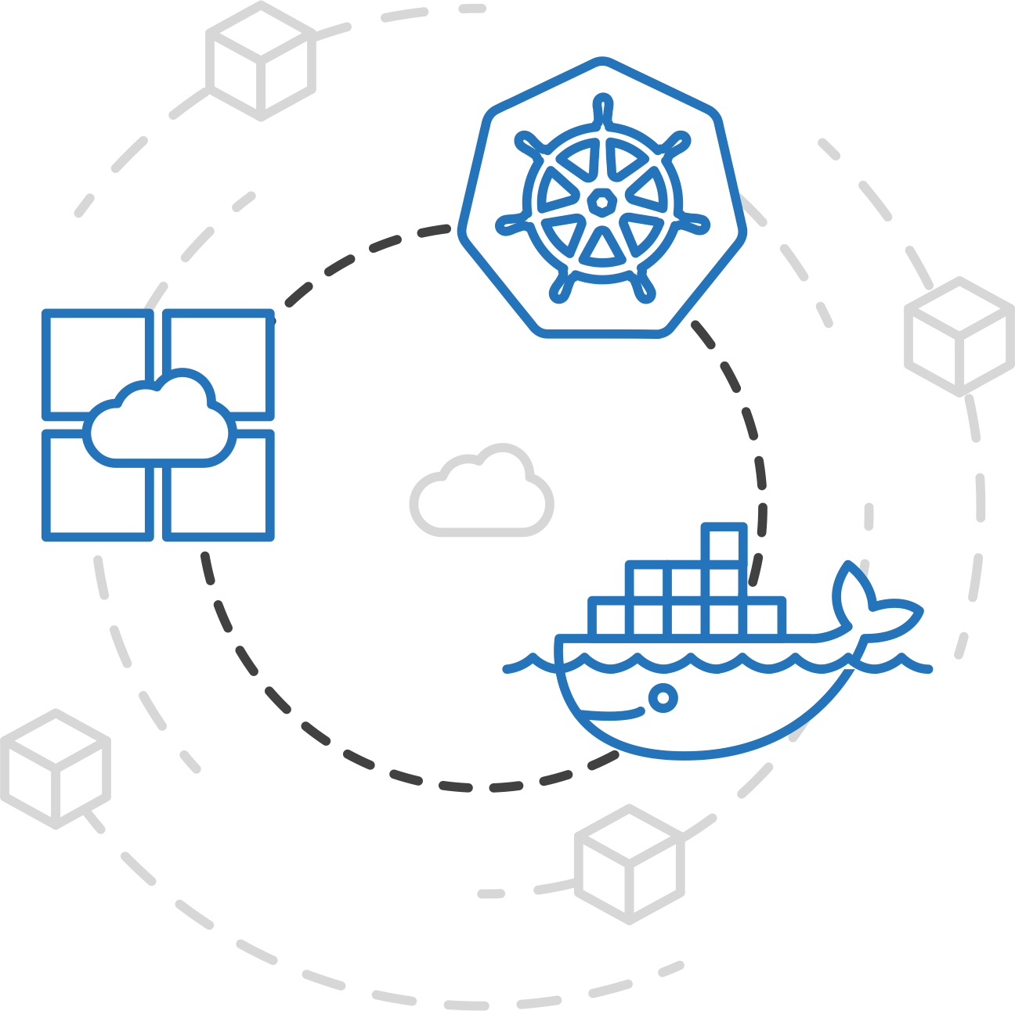
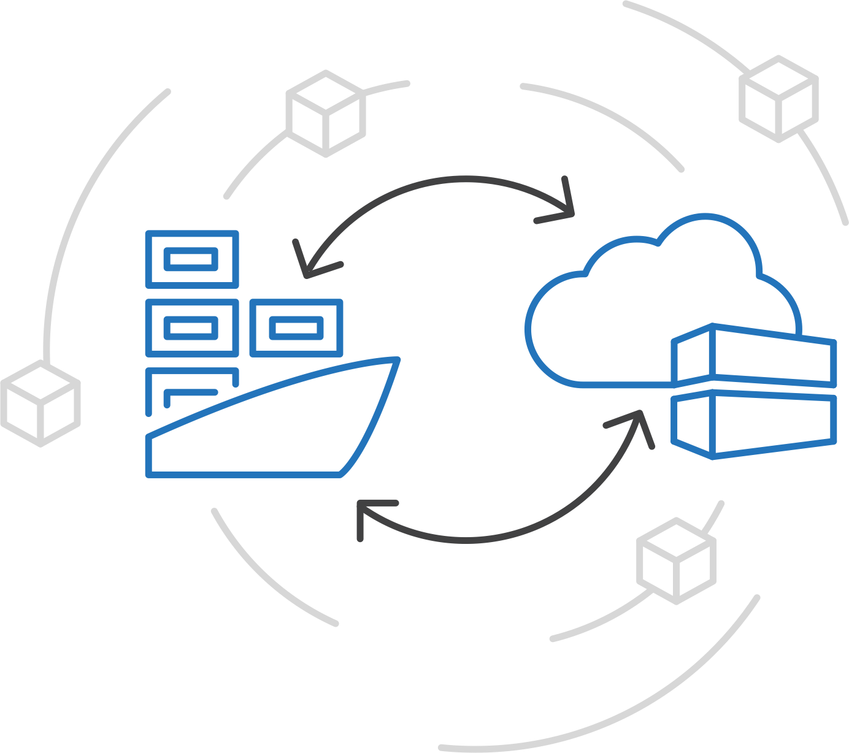
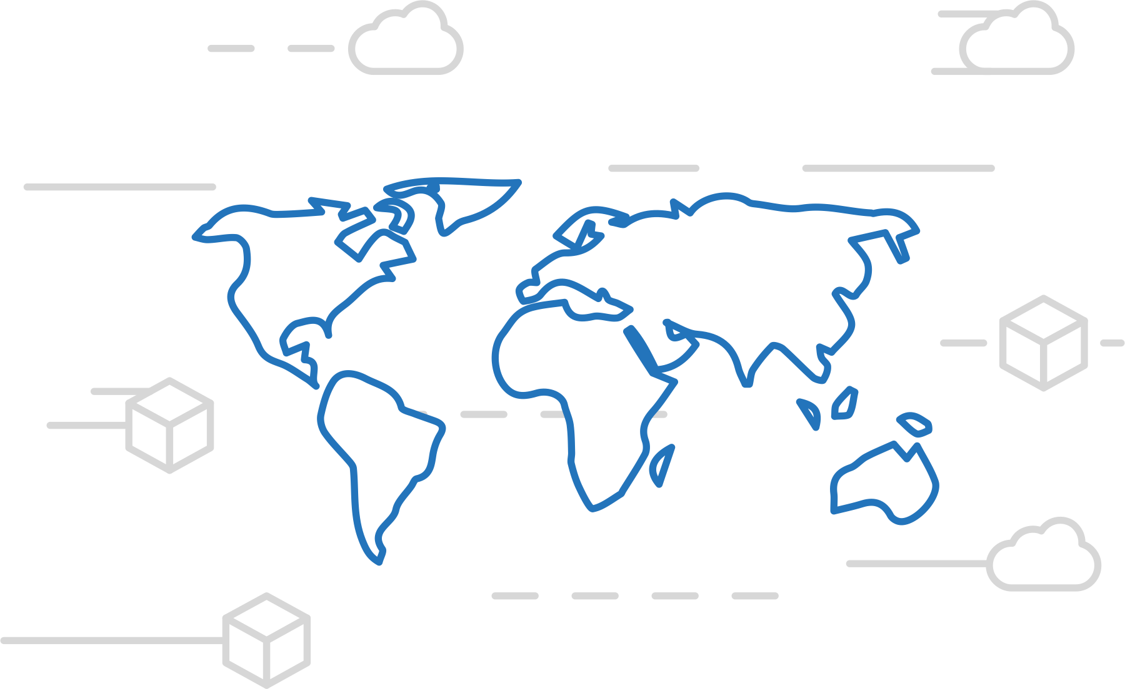

Azure Container Registry
Azure Kubernetes Service (AKS)
Manage a Docker private registry as a first-class Azure resource
Azure Container Instances (ACI)
Azure Container Registry
Open Service Broker API (OSBA)
Manage images for all types of containers
Use familiar, open-source Docker CLI tools
Azure Container Registry geo-replication
Release Automation Tools

Slide 8
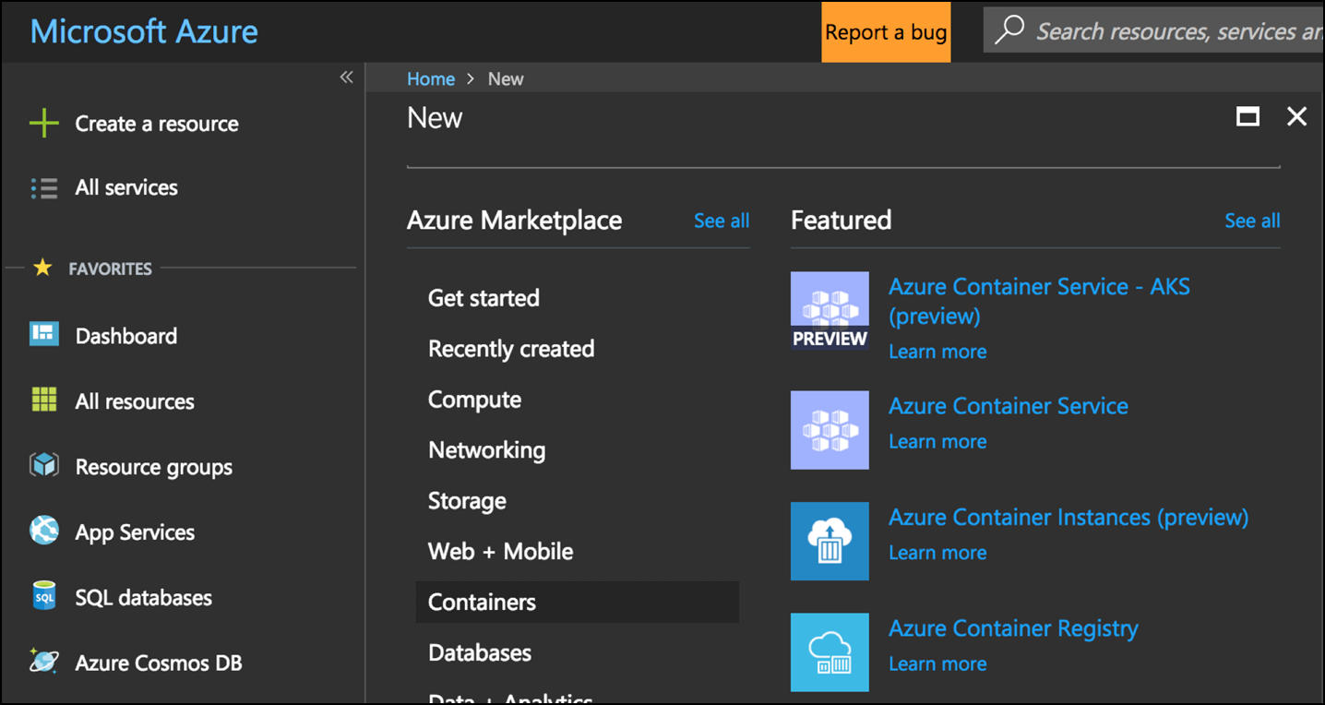
Azure Container Registry
Azure Kubernetes Service (AKS)
Create a container in the Registry quickly
Azure Container Instances (ACI)
Azure Container Registry
Open Service Broker API (OSBA)
Release Automation Tools

Slide 9
Azure Container Instances (ACI)
Azure Container Registry
Open source community
Azure Kubernetes Service (AKS)
Release automation tools
Containers 101
Getting started
Azure container technology
Open Service Broker for Azure (OSBA)
Customer success stories
Container orchestration
Azure Container Instances (ACI)

Slide 10
Azure Container Instances (ACI)
Azure Kubernetes Service (AKS)
Azure Container Instances (ACI)
OSBA
App Service
Azure Container Registry (ACR)
Partner services
Azure services
PaaS
Azure Container Registry
OpenShift
SQL Database
Azure Kubernetes Service (AKS)
Service Fabric
Batch
Pivotal Cloud Foundry
Redis Cache
ACS Engine
Open Service Broker API (OSBA)
Docker Enterprise Edition
CosmosDB
Virtual kubelet
Mesosphere DC/OS
And more!
Azure Container Instances (ACI)
Azure Virtual Machines
Virtual Machine Scale Sets (VMSS)
Release Automation Tools
Azure
IaaS

Slide 11
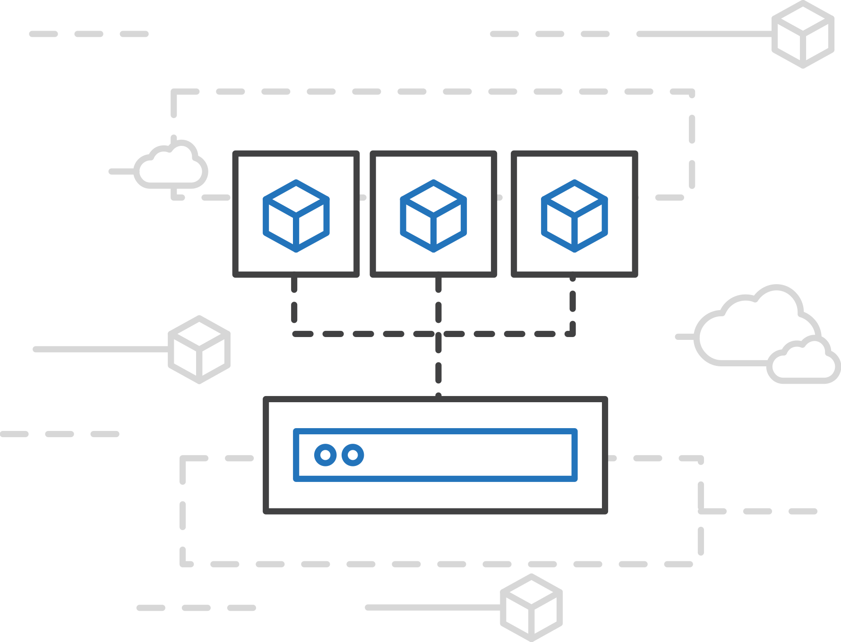
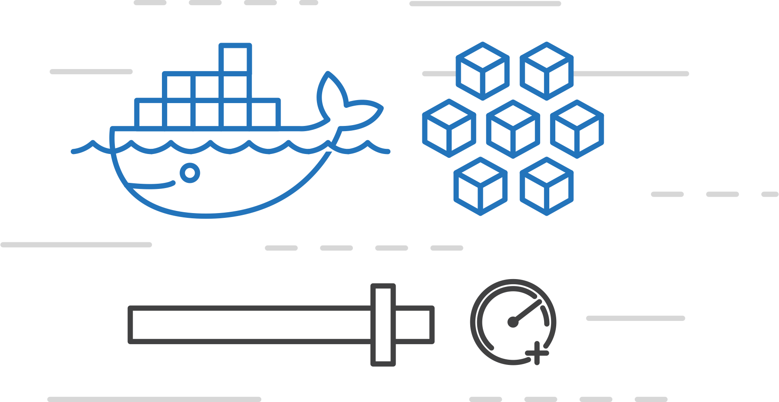
Azure Container Instances (ACI)
Azure Kubernetes Service (AKS)
Easily run containers on Azure with a single command
Azure Container Instances (ACI)
Azure Container Registry
Open Service Broker API (OSBA)
Start using containers right away
Cloud-scale container capacity
Hyper-visor isolation
Release Automation Tools

Slide 12
Azure Container Instances (ACI)
Azure Kubernetes Service (AKS)
Create an Azure Container Instance quickly
Azure Container Instances (ACI)
Azure Container Registry
Open Service Broker API (OSBA)
Release Automation Tools

Slide 13
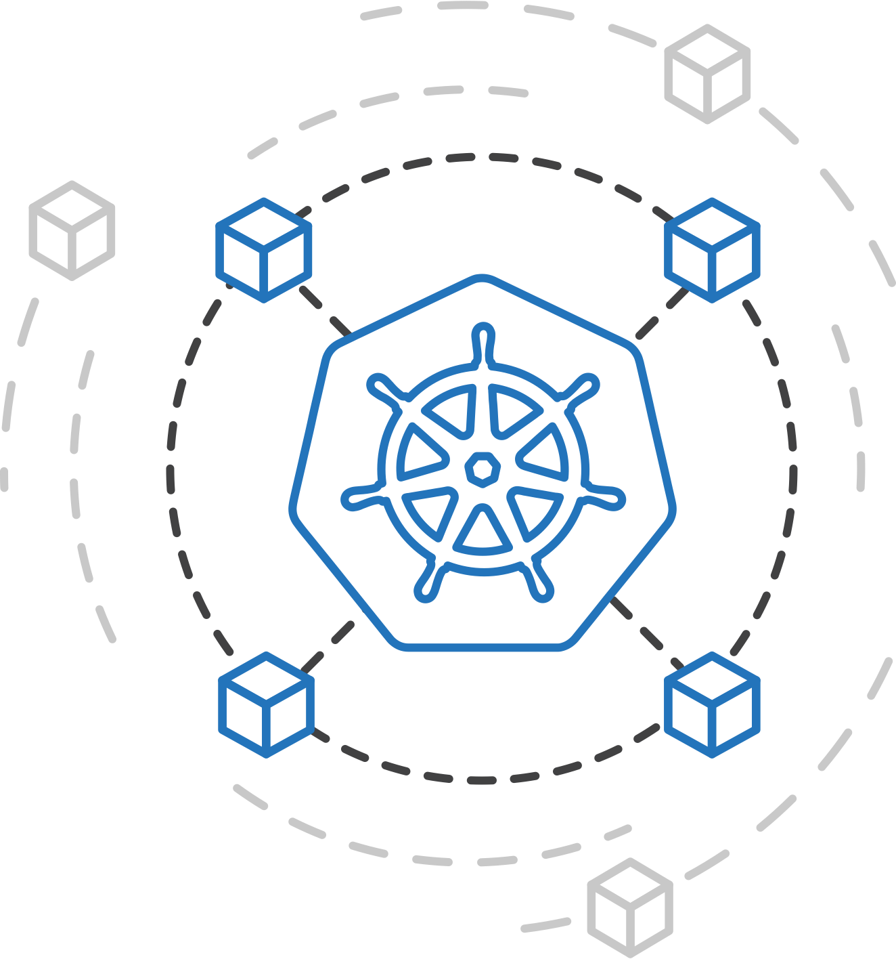
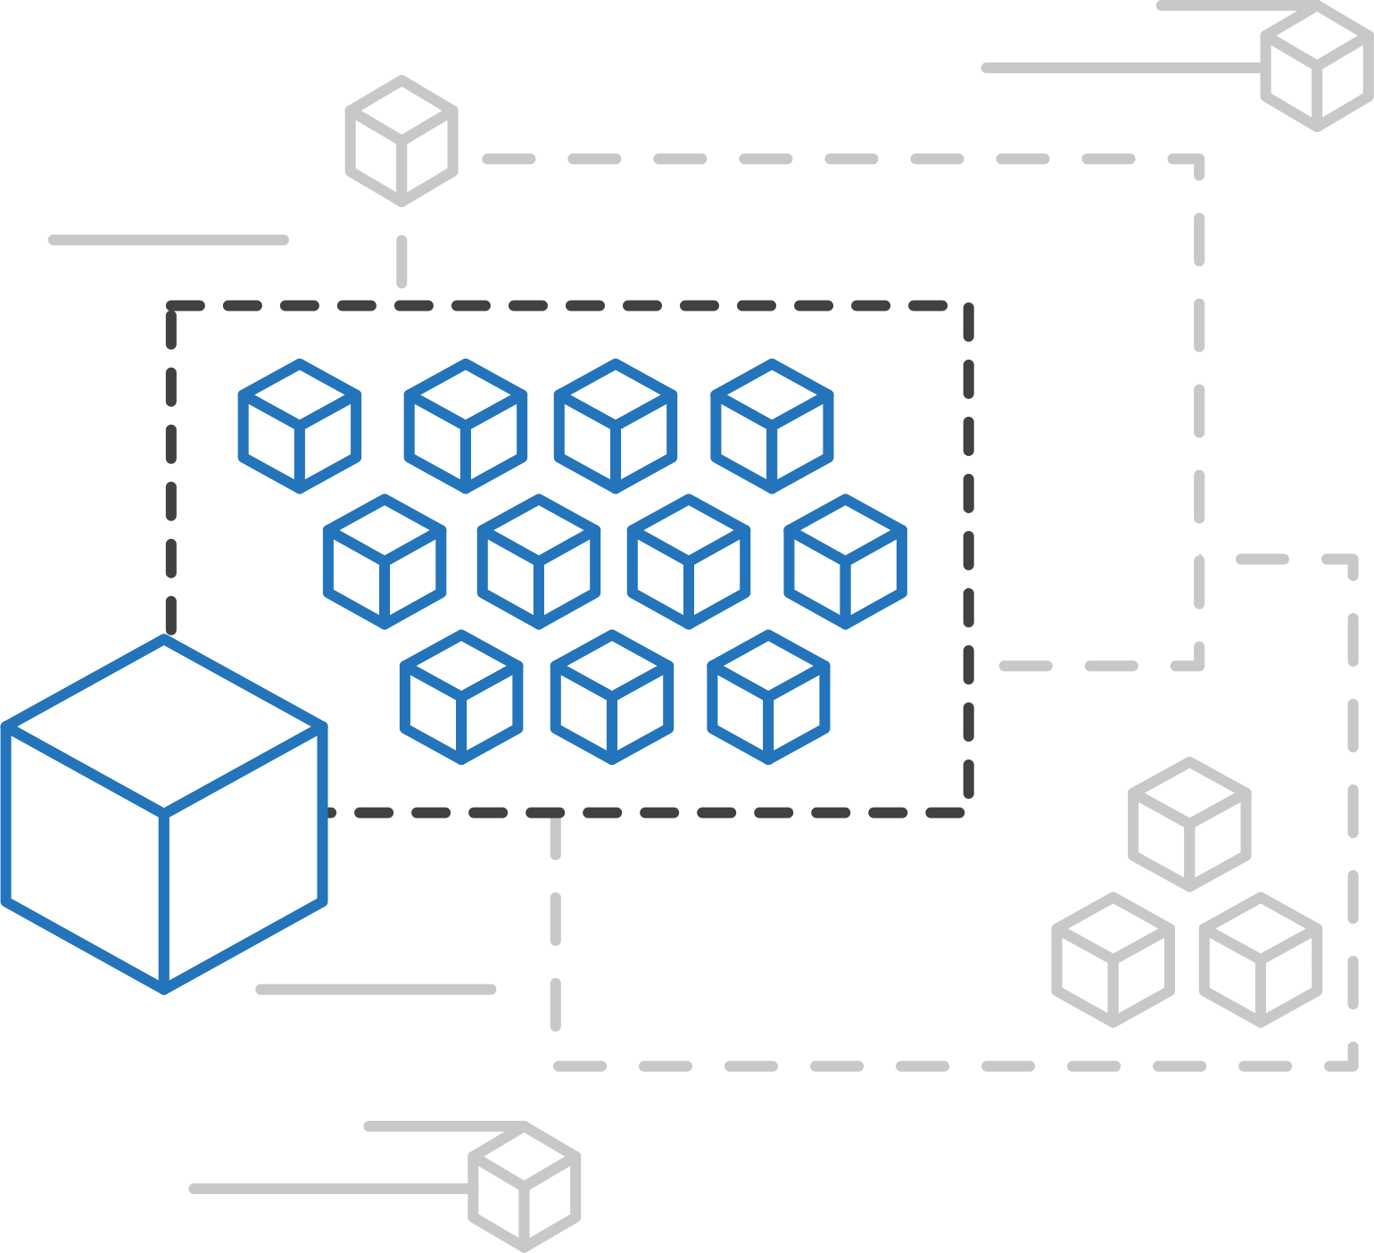
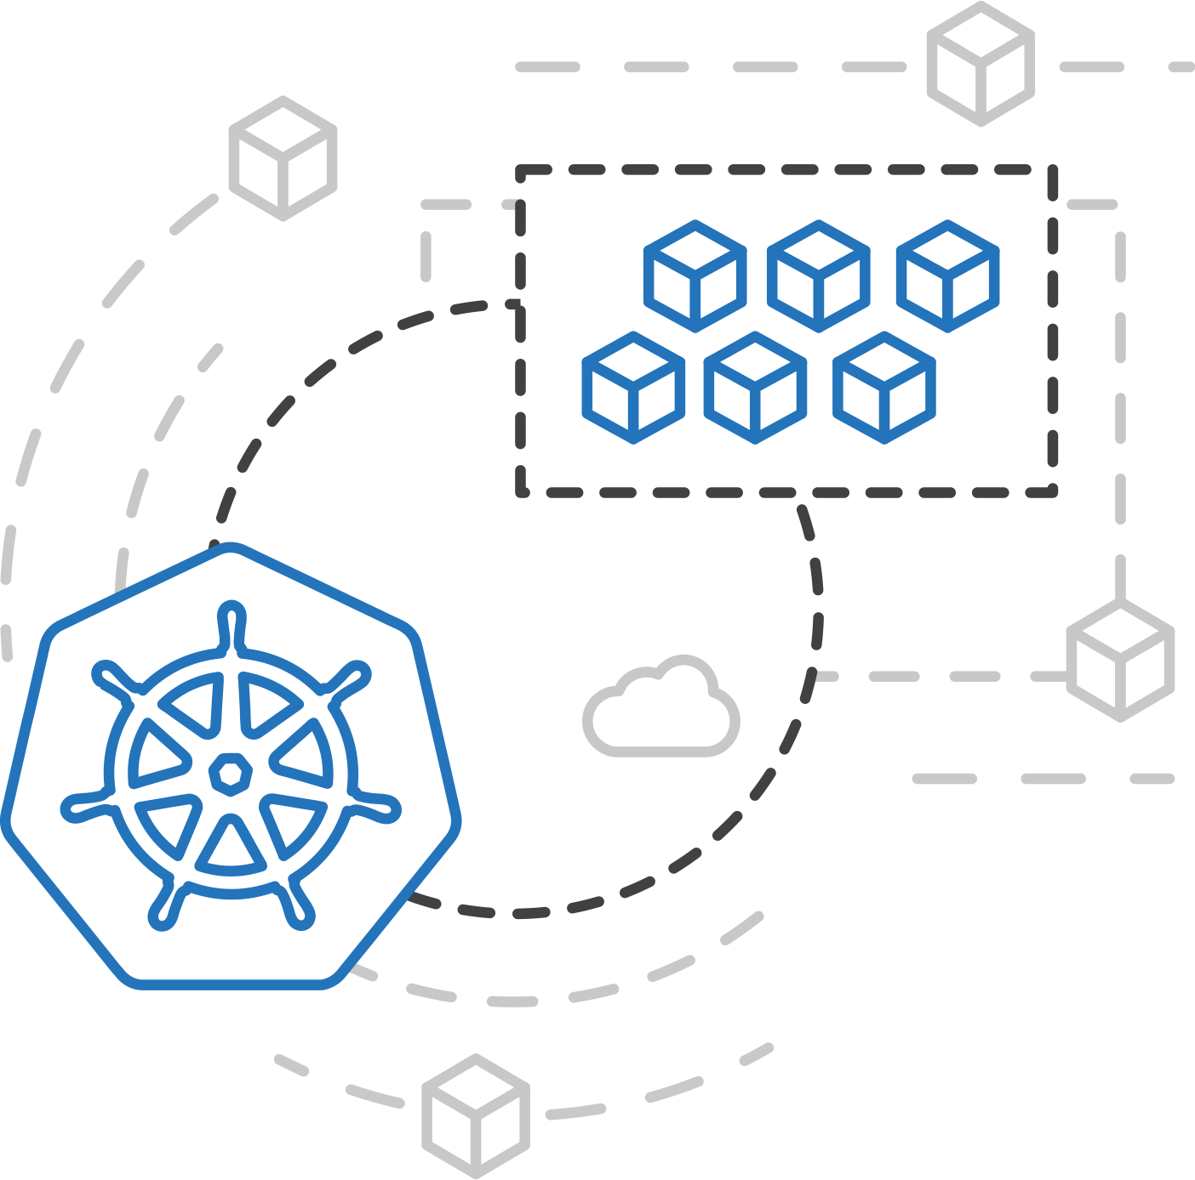
Azure Kubernetes Service (AKS)
Azure Container Instances (ACI)
ACI Connector for Kubernetes
Azure Container Instances (ACI)
Azure Container Registry
Open Service Broker API (OSBA)
Kubernetes provides rich orchestration capabilities
ACI provides infinite container-based scale
The ACI Connector for K8s brings them together
Release Automation Tools

Slide 14
Azure Container Instances (ACI)
Azure Kubernetes Service (AKS)
Bursting with the ACI Connector
Azure Container Instances (ACI)
VM
VM
Pod
Waste
Pod
Pod
Pod
Waste
Pod
Pod
Pod
Pod
Azure Container Registry
Azure Container Instances (ACI)
Pod
Pod
Pod
Pod
Pod
Application architect
Kubernetes control pane
ACI Connector
Pod
Pod
Pod
Pod
Pod
Pod
Pod
Pod
Pod
Pod
Open Service Broker API (OSBA)
Pod
Pod
Pod
Pod
Pod
Deployment/ tasks
Pod
Pod
Pod
Pod
Pod
Infrastructure architect
Release Automation Tools
Pod
Waste
Pod
Pod
Pod
Waste
Pod
Pod
Pod
Pod
VM
VM

Slide 15
Azure Kubernetes Service (AKS)
Azure Container Instances (ACI)
Virtual Kubelet
Azure Container Instances (ACI)
Kubernetes API
Azure Container Registry
Node
Node
Node
Node
virtual kubelet
Kubelet
Kubelet
Kubelet
Kubelet
Open Service Broker API (OSBA)
Release Automation Tools
Typical kubelets implement the pod and container operations for each node as usual.
Virtual kublet registers itself as a “node” and allows developers to program their own behaviors for operations on pods and containers.

Slide 16
Azure Kubernetes Service (AKS)
Azure Container Registry
Open source community
Azure Kubernetes Service (AKS)
Release automation tools
Containers 101
Getting started
Azure container technology
Open Service Broker for Azure (OSBA)
Customer success stories
Container orchestration
Azure Container Instances (ACI)

Slide 17
Azure Kubernetes Service (AKS)
Azure Kubernetes Service (AKS)
Azure Container Instances (ACI)
OSBA
App Service
Azure Container Registry (ACR)
Partner services
Azure services
PaaS
Azure Container Registry
OpenShift
SQL Database
Azure Kubernetes Service (AKS)
Service Fabric
Batch
Pivotal Cloud Foundry
Redis Cache
ACS Engine
Open Service Broker API (OSBA)
Docker Enterprise Edition
CosmosDB
Virtual kubelet
Mesosphere DC/OS
And more!
Azure Container Instances (ACI)
Azure Virtual Machines
Virtual Machine Scale Sets (VMSS)
Release Automation Tools
Azure
IaaS

Slide 18
Container Management at Scale
Cluster Management: deploy and manage cluster resources
Scheduling: where containers run
Lifecycle & Health: keep containers running despite failure
Service Discovery & Load Balancing: where are my containers and how to connect
Security: control access to cluster resources and protect secrets
Scaling: make sets of containers elastic in number
Image repository: centralized, secure Docker container images
Continuous Delivery: CI/CD pipeline and workflow
Logging & Monitoring: track what’s happening in containers and cluster
Storage volumes: persistent data for containers
Notes:
“Container-centric infrastructure”
Additionally: configuration management, debugging/introspection, identity and authorization

Slide 19
Kubernetes: empowering you to do more
Deploy your applications quickly and predictably
Scale your applications on the fly
Roll out new features seamlessly
Limit hardware usage to required resources only

Slide 20
Azure Kubernetes Service (AKS)
Azure Kubernetes Service (AKS)
A fully managed Kubernetes cluster
Azure Container Instances (ACI)
Managed control pane
Automated upgrades, patches
Easy cluster scaling
Self-healing
Cost savings
Azure Container Registry
Managed
Application architect
Applications
Open Service Broker API (OSBA)
Operations
Kubernetes
Infrastructure architect
Docker
Release Automation Tools
Azure infrastructure services

